Slide 1

Understanding Financial Statements: A Comprehensive Overview
Financial Management(HS4L003)
Dr. Naresh Chandra Sahu
Associate Professor (Economics)
School of Humanities, Social Sciences & Management
Indian Institute of Technology, Bhubaneswar

Slide 2

Learning Outcomes
Understand the purpose and users of financial statements.
Identify components and functions of the Income Statement.
Analyze the Balance Sheet structure and elements.
Understand cash flows from operating, investing, and financing activities.
Interpret sample financial statements and apply basic formulas.
Assess a company's financial health using key statements.

Slide 3
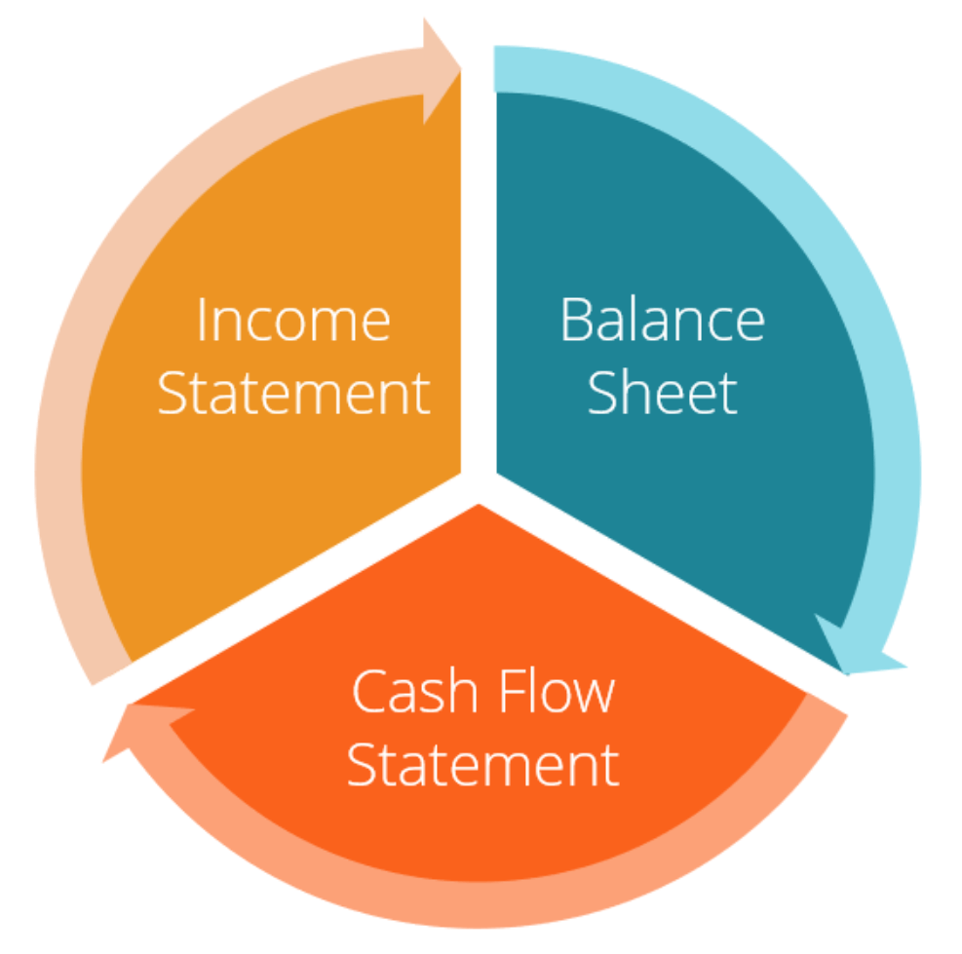
Financial Statement
Financial statements are formal records that show the financial performance, position, and cash flow of a business.
They are used by
Investors (to decide whether to invest)
Creditors (to decide whether to lend)
Management (for internal decisions)
Government and regulators (for compliance)

Slide 4
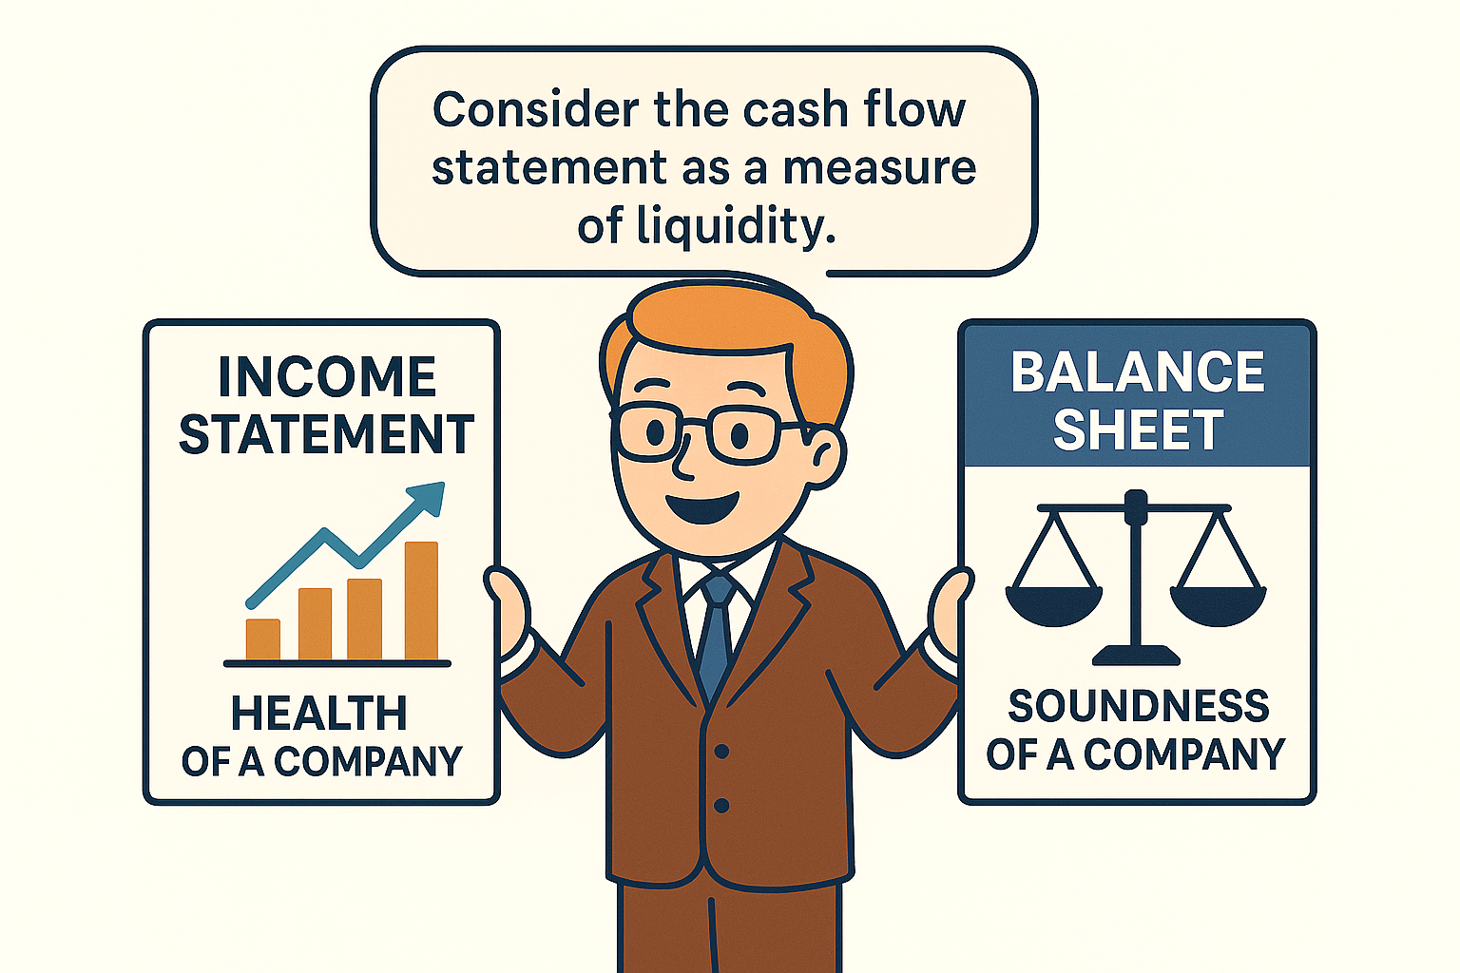

Slide 5
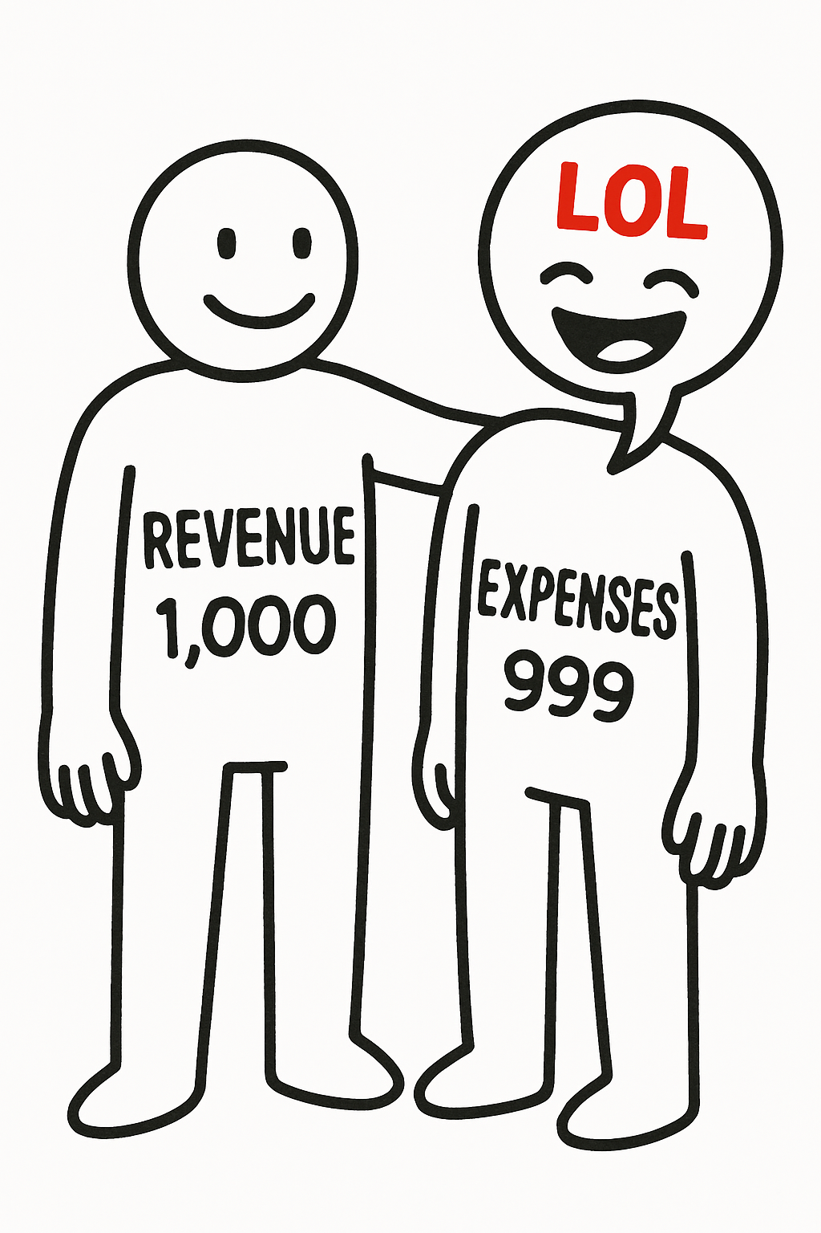
Income Statement
An Income Statement is a financial report that shows a company’s revenues, expenses, and profit or loss over a specific period (e.g., a quarter or a year).
Purpose of the Income Statement
Measures how much profit or loss a company made
Helps investors, creditors, and managers make decisions
Shows company performance over time
Ensures transparency and compliance

Slide 6
Income Statement
Components of an Income Statement
A. Sales/Revenue
Gross Revenue / Sales – Total sales before any deductions
Less: Returns and Allowances – Goods returned or discounts given
Net Revenue – Revenue after deductions
B. Cost of Goods Sold (COGS)
Direct cost of producing goods sold in a period. Includes raw materials, labor, and manufacturing costs.
COGS = Opening Stock + Purchases - Closing Stock
C. Gross Profit
Gross Profit = Net Revenue – COGS

Slide 7
Income Statement
D. Operating Expenses
Costs related to daily business operations that are not directly linked to production.
Examples include:
  Salaries and wages
  Rent
  Office supplies
  Advertising
  Utilities
E. Operating Income (EBIT - Earnings Before Interest and Tax)
Profit from regular operations before interest and taxes.
Operating Income = Gross Profit - Operating Expenses

Slide 8
Income Statement
F. Other Income(Non-Operating Expenses )
Income or losses from non-operating activities, like interest earned, investment income, or asset sales.
G. Profit Before Tax (PBT)
  Profit after all expenses, except taxes.
  PBT =Operating Profit + Other Income – Other Expenses
H. Tax Expense
Tax payable to the government.
I. Net Profit
The final profit is the amount remaining after paying taxes. This is the bottom line of the income statement.
Net Profit = Profit Before Tax – Corporate Tax

Slide 9
Income Statement
INFOSYS LIMITED
Income Statement
31 March, 20YY ( in crore)
Net Sales 4,358,100
Costs of Sales 2,738,714
GROSS PROFIT 1,619,386
Selling and Operating Expenses 560,430
General and Administrative Expenses 293,729
TOTAL OPERATING EXPENSES 854,159
OPERATING INCOME 765,227
Other Income 960
Gain(Loss) on the Financial Instruments 5,513
(Loss) Gain on the Foreign Currency 12,649
Interest Expenses 18,177
INCOME BEFORE TAX 740,874
Corporate Tax Expense 257,642
NET INCOME 483,232

Slide 10
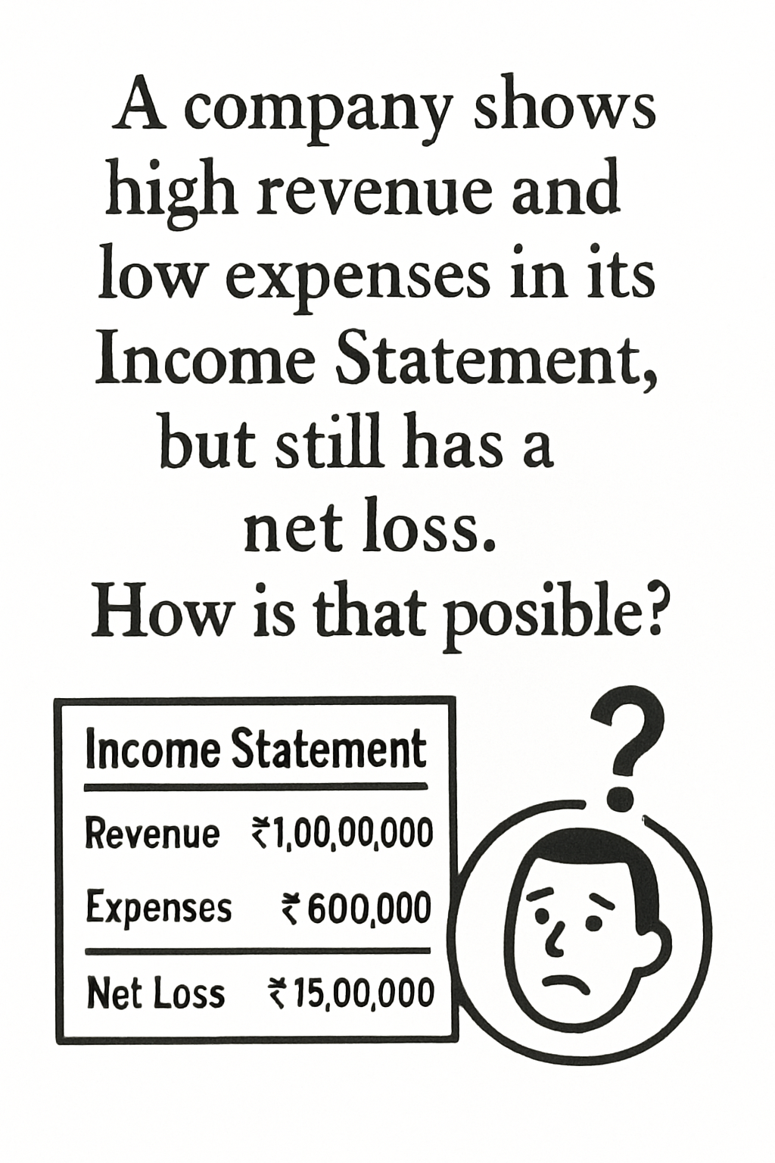

Slide 11
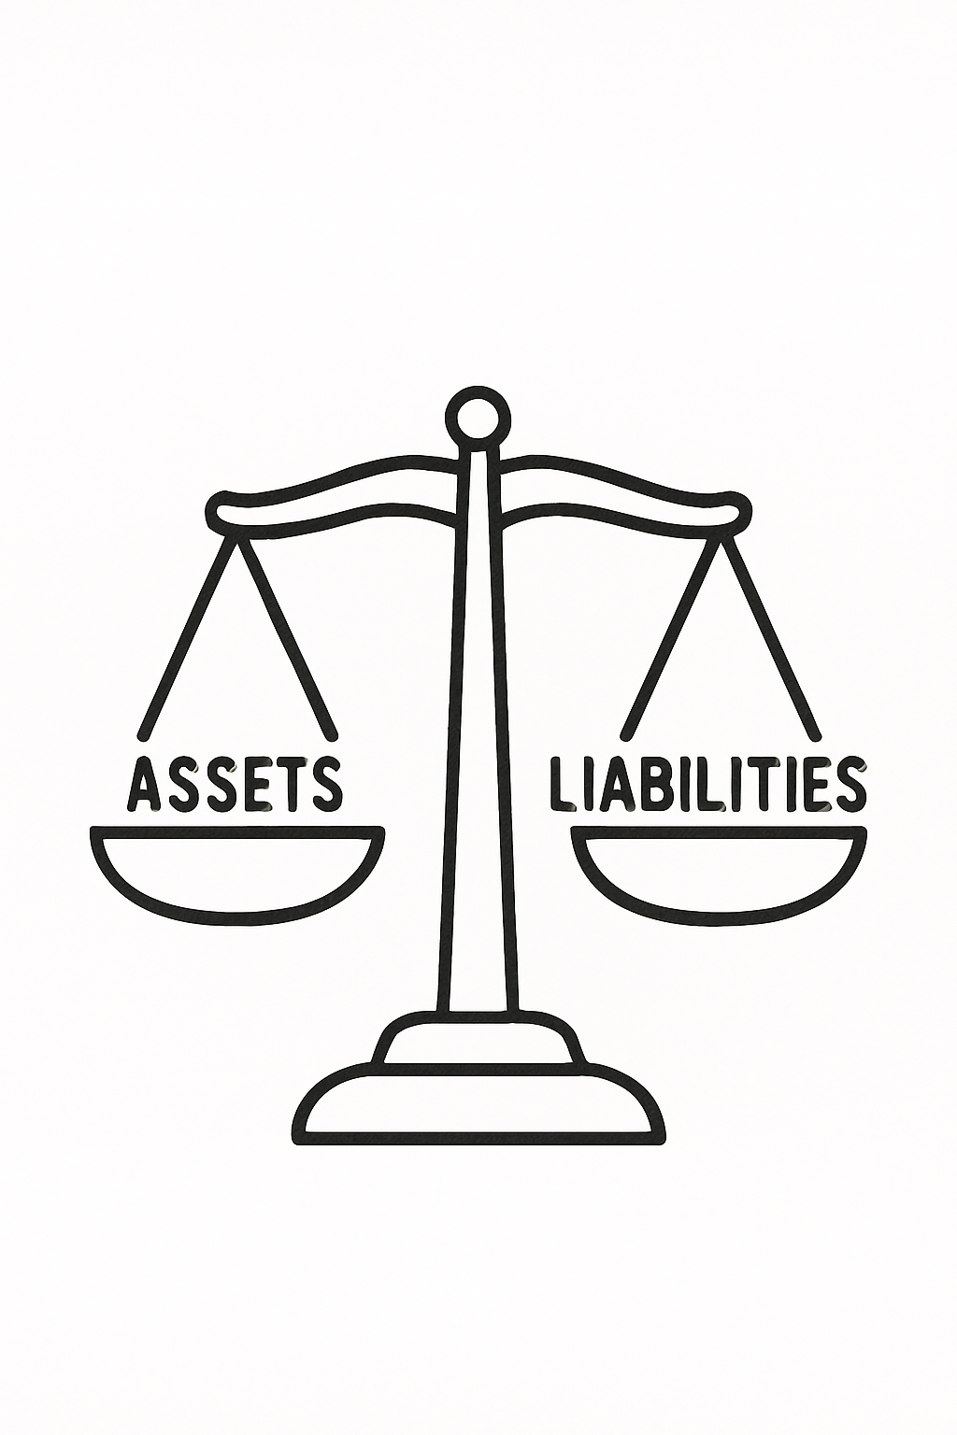
Balance Sheet
A balance sheet is a financial statement that shows a company's financial position at a specific point in time. It presents the assets, liabilities, and owner’s equity of a business.
Purpose of the Balance Sheet
Shows the company's financial health
Helps assess liquidity, solvency, and capital structure
Useful for investors, creditors, and management decisions
Verifies that Assets = Liabilities + Equity
The balance sheet is structured into three main parts:
Assets
Liabilities
Owner’s Equity / Shareholder’s Equity

Slide 12
Balance Sheet
Components of a Balance Sheet
Assets (What the Company Owns)
Current Assets (within 1 year)
These are liquid or convertible to cash in the short term:
Cash & Cash Equivalents – money in bank or on hand
Accounts Receivable – money owed by customers
Inventory – goods ready for sale
Prepaid Expenses – rent, insurance paid in advance
Non-Current Assets (long-term)
Property, Plant & Equipment (PPE) – land, buildings, machines
Intangible Assets – goodwill, patents, trademarks
Long-term Investments – equity or debt investments not for sale within a year

Slide 13
Balance Sheet
Liabilities (What the Company Owes)
Current Liabilities
To be paid within a year:
Accounts Payable – bills to suppliers
Short-term Debt – bank overdrafts, short-term loans
Accrued Expenses – salaries, utilities due
Taxes Payable – unpaid taxes
Non-Current Liabilities
Obligations due after 1 year:
Long-term Loans – from banks or bonds
Deferred Tax Liabilities – taxes owed in the future
Lease Obligations – for long-term rented assets

Slide 14
Balance Sheet
INFOSYS LIMITED
Balance Sheet 31 March, 20YY ( in crore)
ASSETS
Current Assets 9,609
Long-Term Investments &Funds 1,460
Property, Plant & Equipment 9,716
Intangible Assets 1,222
Other Assets 68
Total Assets 22,075
LIABILITIES
Current Liabilities 3,464
Long Term Liabilities 5,474
Total Liabilities 8,938
OWNERS EQUITY
Contributed Capital 3,464
Retained Earnings 5,474
Total Owners Equity 13,137
Total Liabilities and Equities 22,075
Shareholders’ Equity (Net Worth)
Also called owner’s equity or net assets:
Common Stock / Share Capital – funds raised from issuing shares
Retained Earnings – cumulative profits kept in the business
Reserves & Surplus – extra funds set aside (like for R&D, depreciation, etc.)
Equity = Assets - Liabilities

Slide 15
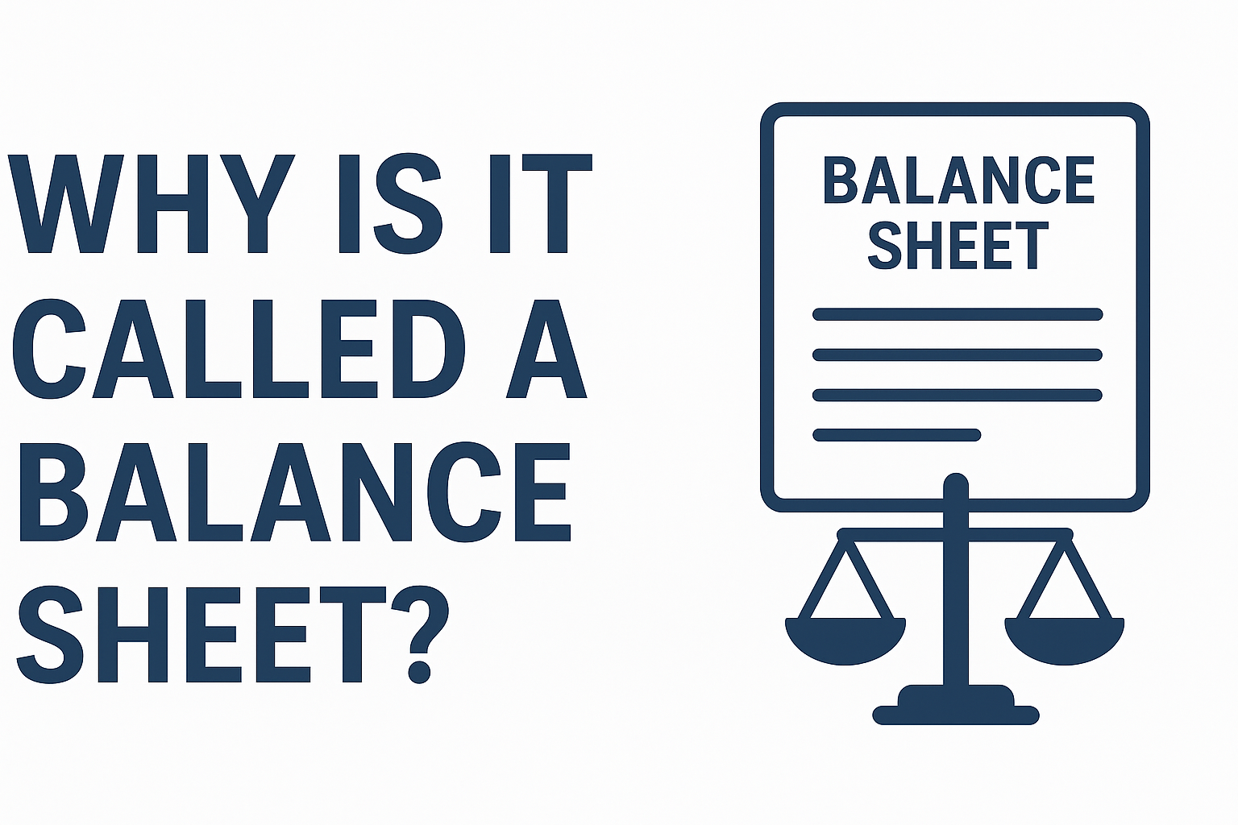

Slide 16
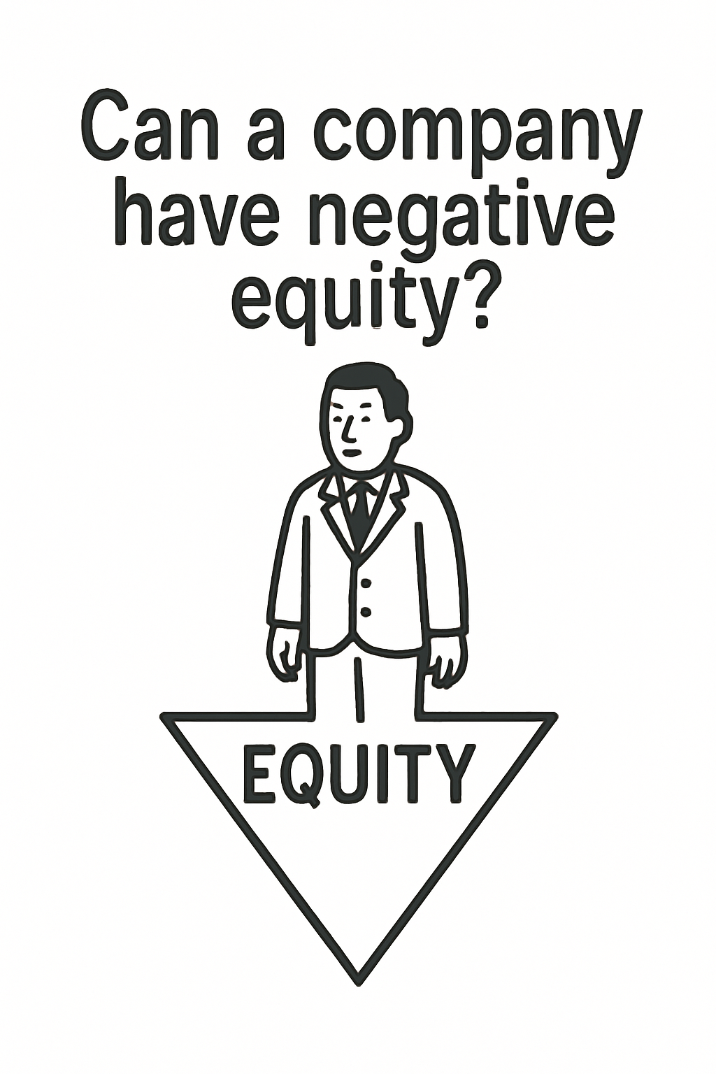

Slide 17
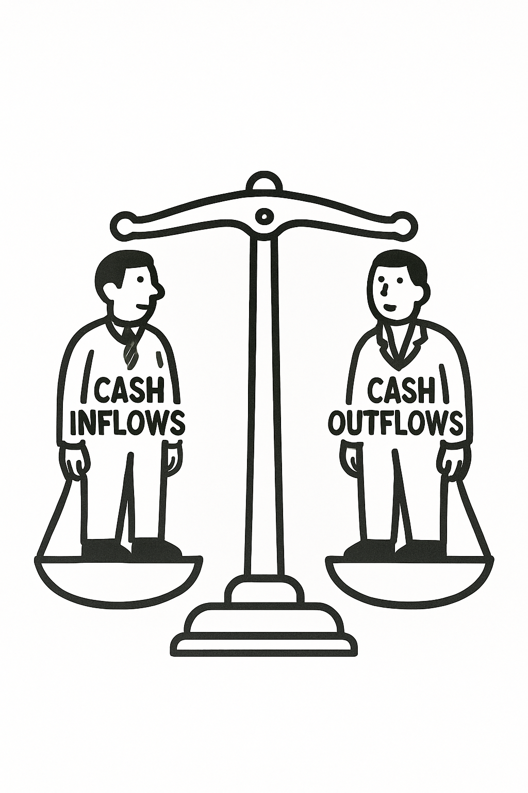
Cash Flow Statement
The Cash Flow Statement (CFS) shows the actual inflow and outflow of cash in a company during a specific period.
Purpose of the Cash Flow Statement
Tracks cash inflows and outflows
Shows the company’s liquidity position
Highlights operating performance
Aids in financial decision-making
Reveals true cash health beyond profits

Slide 18
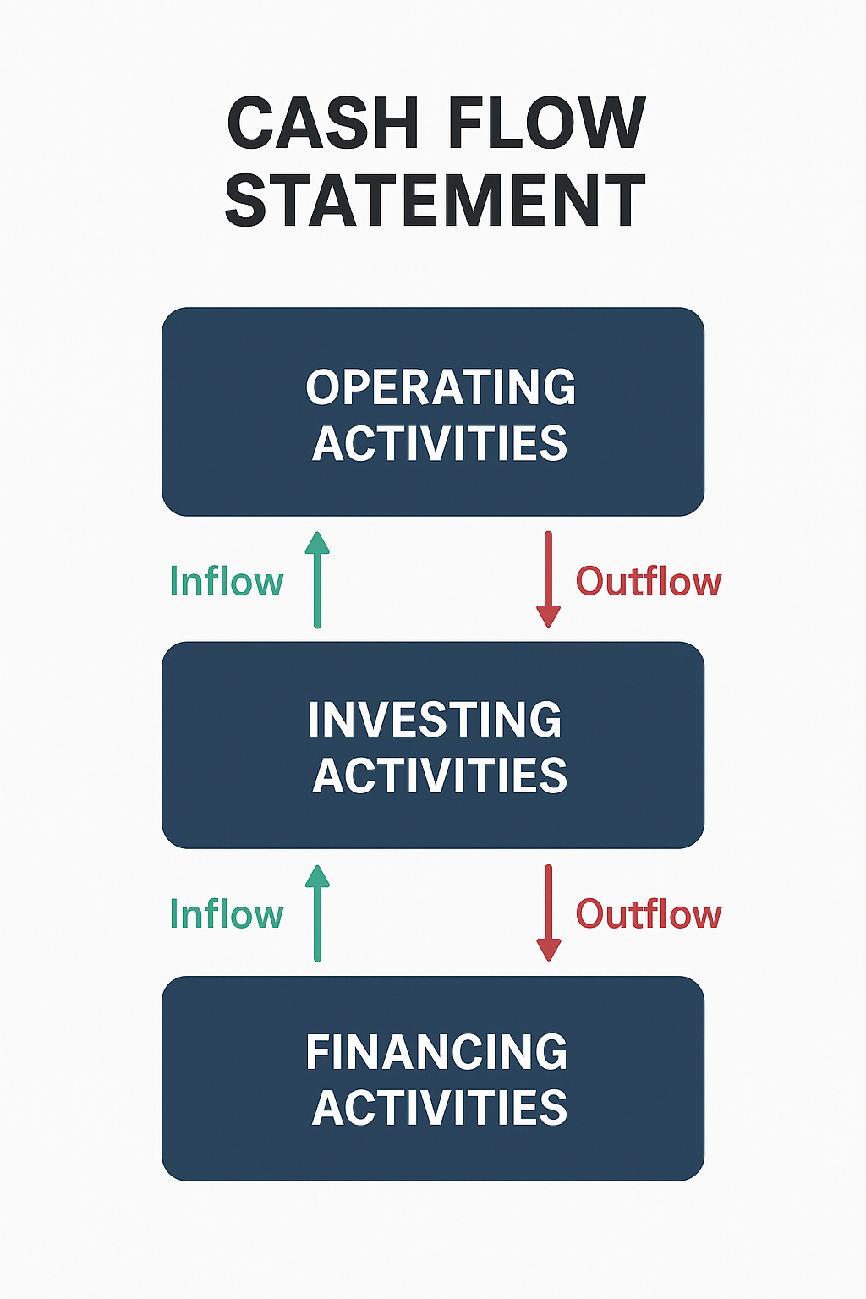

Slide 19
Cash Flow Statement
Cash Flow from Operating Activities (CFO)
Core business operations include day-to-day revenue and expense transactions.
Formula :
CFO=Net Income + Non-Cash Expenses + Changes in Working Capital
Inflow
Outflow
Cash sales/collection from customers
Interest received
Dividends received (under some accounting standards
Cash paid to suppliers
Salaries, rent, utilities
Interest paid
Taxes paid

Slide 20
Cash Flow Statement
Cash Flow from Investing Activities (CFI)
Buying/selling assets or investments not related to day-to-day operations.
Formula:
CFI=Cash Inflows from Sale of Assets−Cash Outflows for Purchases
Inflow
Outflow
Purchases of property, plant, equipment (capex)
Investment in stocks, bonds, or subsidiaries
Loans/advances given
Sale of property, equipment, land
Sale of long-term investments
Sales of subsidiaries/assets

Slide 21
Cash Flow Statement
Cash Flow from Financing Activities (CFF)
Raising or repaying capital and loans.
Inflow
Outflow
Repayment of loans
Dividend payments
Shares buybacks.
Issuing shares (equity financing)
Barrowing (bank loans, bonds
CFF=(Proceeds from Issuing Shares + Proceeds from Borrowings)− (Loan Repayments + Dividend Payments + Share Buyback)

Slide 22
Cash Flow Statement
INFOSYS LIMITED
Cash Flow Statement
31 March 20YY(in crore)
CASH FLOW FROM OPERATIONS
Net Earnings 2,000,000
Additions to Cash
Depreciations 10,000
Depreciations in Accounts Receivable 15,000
Increase in Accounts Payable 2,000
Subtractions From Cash
Increase in Inventory 30,000
Net Cash From Operations 2,012,000
CASH FLOW FROM INVESTING
Equipment 500,000
CASH FLOW FROM FINANCING
Notes Payable 10,000
Cash Flow For FY Ended 21 Dec 20YY 1,522,000

Slide 23
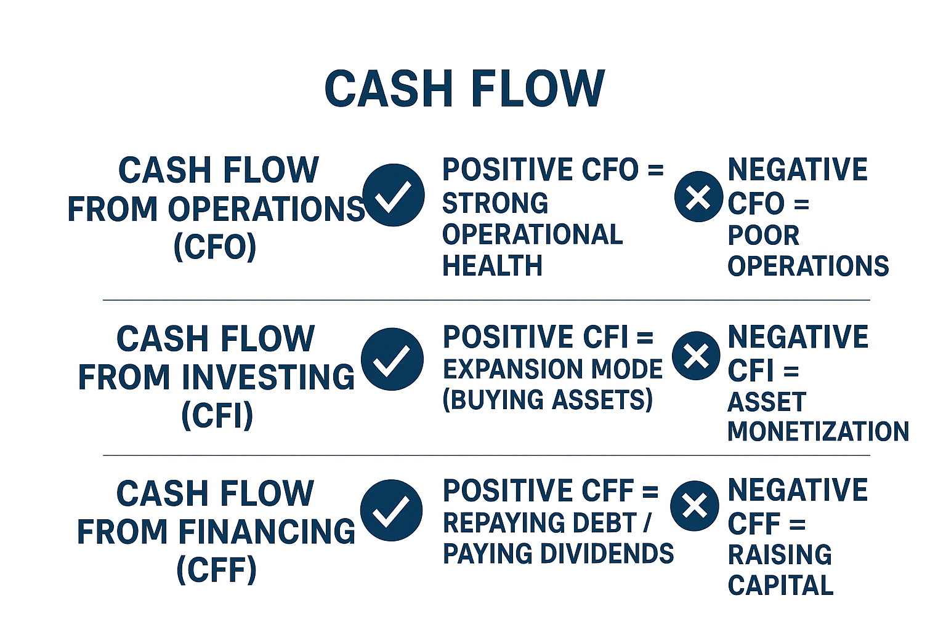

Slide 24
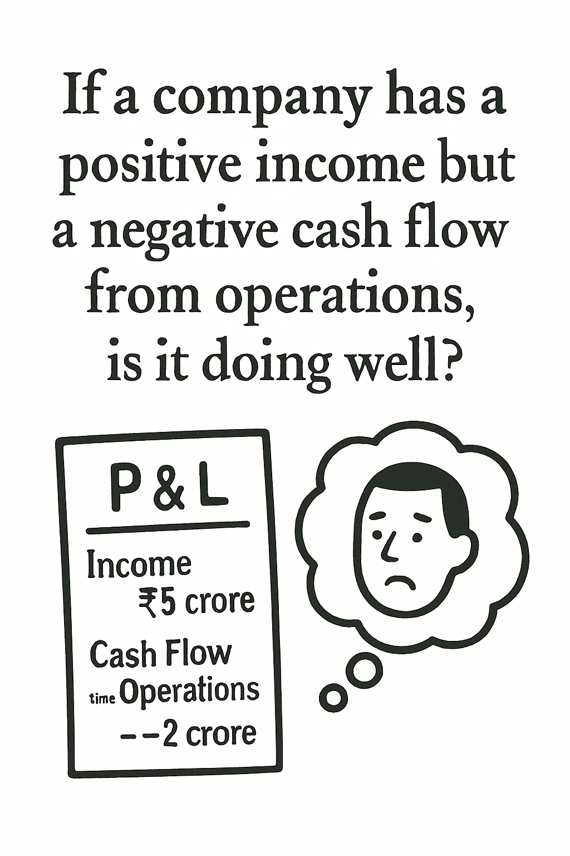

Slide 25

Imagine three friends Income Statement, Balance Sheet, and Cash Flow go on a road trip. One keeps bragging about how rich they are, one quietly writes down who owns the car and who owes the bank, and one checks the fuel tank to see if the trip can continue. Who is who and why?

